Slide 1
SOFTWARE TESTING

Slide 2
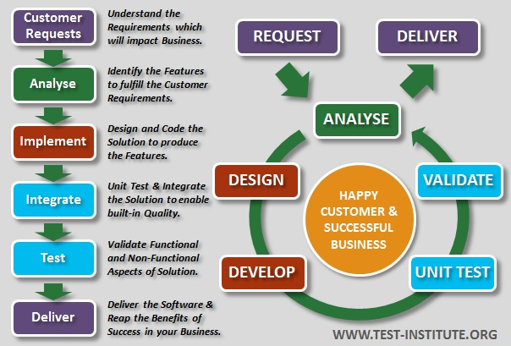
Introduction to Software Testing
Software testing is nothing but an art of investigating software to ensure that its quality under test is in line with the requirement of the client.
Software testing is carried out in a systematic manner with the intent of finding defects in a system. It is required for evaluating the system. As the technology is advancing we see that everything is getting digitized.
You can access your bank online, you can shop from the comfort of your home, and the options are endless. Have you ever wondered what would happen if these systems turn out to be defective.
One small defect can cause a lot of financial loss. It is for this reason that software testing is now emerging as a very powerful field in IT.

Slide 3
Definition of Software Testing
Testing is the process of exercising a program with specific intent of finding the errors prior to delivery to the end user.
It is the process of executing a system to identify the errors or bugs.
Software testing process we executing program or application having the intent of finding the error in the software bugs.
Meets with the requirements and guideline of the development.
Work of software has done as expected.
The software can be implemented with the same feature.

Slide 4
Needs of Software Testing
The goal of software testing is to find errors, gaps, or missing requirements in comparison to the actual requirements. When a software development project is going on, you need to know that errors may appear in any phase of the life cycle. Few of them are known to be undiscovered.
The major objectives of Software testing are as follows: Finding defects which may get created by the programmer while developing the software. Gaining confidence in and providing information about the level of quality. To prevent defects.
Software Testing is necessary because we all make mistakes. Some of those mistakes are unimportant, but some of them are expensive or dangerous. We need to check everything and anything we produce because things can always go wrong – Humans make mistakes all the times.

Slide 5

Causes of Software Defects
Defects are defined as the deviation of the actual and expected result of system or software application. Defects can also be defined as any deviation or irregularity from the specifications mentioned in the product functional specification document. Defects are caused by the developer in development phase of software.
There are many reasons for the occurrence of Software Bugs. The most common reason is human mistakes in software design and coding.
Once you get to know the causes for Software Defects, then it will be easier for you to take corrective actions to minimize these defects.

Slide 6
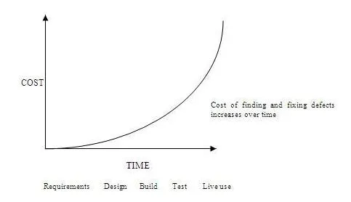
Costs of Software Defects
The cost of defects identified during Software Testing, completely depends on the impact of the defects found. The earlier the defect is found, easier and less costly it is to fix these defects. For instance, if there is a defect found in the project requirement specifications and analysis, then it is relatively cheaper to fix it.
Similarly, if the defects or failures are found in the design of the software, then the product design is corrected and then re-issued. However, if these defects somehow get missed by testers and if they are identified during the user acceptance phase, then it can be way too expensive to fix such type of errors.
If during the software development process, an error is made and the consequent defect is detected in the requirements phase itself, then it is relatively cheaper to fix it. This is because the software is not yet in developing stage and it is easy to make requirement specified changes.

Slide 7
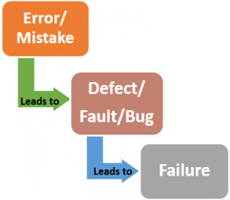
Errors - Defect - Failure

Slide 8
Errors
The Error is a human mistake. An Error appears not only due to the logical mistake in the code made by the developer. Anyone in the team can make mistakes during the different phases of software development. For instance
Types of Error
User Interface Error: These are the errors that generally appear during user interaction with the system. Such as missing or incorrect functionality of the system, no backup function or reverse function available, etc.
Error handling error: Any error that occurs while the user is interacting with the software needs precise and meaningful handling. If not, it confuses. Therefore, such errors are known as error handling errors.
Syntactic error: Misspelled words or grammatically incorrect sentences are Syntactic errors and are very evident when testing the software GUI.
Calculation errors: These errors occur due to bad logic, incorrect formulas, mismatched data type, etc.
Testing errors: It implies the errors that occurred when implementing and executing the test process. For example, bug scanning failure, inefficiency in reporting an error or defect.
Hardware errors: Such errors are related to the hardware device. Such as no availability and no compatibility with the device.

Slide 9
Defect
A Defect is a variance between expected and actual results. An Error that the tester finds is known as Defect. A Defect in a software product reflects its inability or inefficiency to comply with the specified requirements and criteria and, subsequently, prevent the software application from performing the desired and expected work. The defect is also known as Fault.
Types of defects :
Critical: Defects that are "critical" require immediate attention and treatment. A critical defect directly affects the essential functionalities which can otherwise affect a software product or its large-scale functionality. For instance, failure of a feature/functionality or collapse of the entire system, etc.
2.Major: Defects, which are responsible for affecting the main functions of a software product are Major Defects. Although, these defects do not result in the complete failure of a system but may bring several primary functions of the software to rest.
3.Minor: These defects produce less impact and have no significant influence on a software product. The results of these defects are visible in the operation of the product. However, it does not prevent users from executing the task. The task can be carried out using some other alternative.
4.Trivial: These types of defects have no impact on the operation of a product. Hence, sometimes, we ignore and omit them. For example, spelling or grammatical errors.

Slide 10
Failure:
Failure is a consequence of a Defect. It is the observable incorrect behaviour of the system. Failure occurs when the software fails to perform in the real environment.
In other words, after the creation & execution of software code, if the system does not perform as expected, due to the occurrence of any defect; then it is termed as Failure. Not all Defects result in Failures; some remain inactive in the code, and we may never notice them.
Failures also occur due to the following reasons:
Any physical damage or overheating in the hardware can cause the whole system to fail.
If the software is not compatible with the hardware, then also the system performs unexpectedly.
Failures also happen by environmental conditions like a radiation burst, a strong magnetic field, electronic fields, or pollution could cause faults in hardware or software.

Slide 11
What does Software testing Reveal….?
# Software testing is the process of evaluating and verifying that a software product or application does what it is supposed to do. The benefits of testing include preventing bugs, reducing development costs and improving performance.
* A primary purpose of testing is to detect software failures so that defects may be discovered and corrected. Testing cannot establish that a product functions properly under all conditions, but only that it does not function properly under specific conditions

Slide 12
Importance of Software Testing
It assures the quality of the product and satisfies the customers as well as users. Also, it promises better business optimization (less maintenance cost), reliability, and superior user experience.
Saves Money. First and foremost, software testing saves money. ...
Inspires Customer Confidence and Satisfaction. That translates directly to your customers. ...
Improves Security. ...
Improves Product Quality.

Slide 13
Testing and Quality
Quality Assurance | Quality Control | Testing
QA includes activities that ensure the implementation of processes, procedures and standards in context to verification of developed software and intended requirements. | It includes activities that ensure the verification of a developed software with respect to documented (or not in some cases) requirements. | It includes activities that ensure the identification of bugs/error/defects in a software.
Focuses on processes and procedures rather than conducting actual testing on the system. | Focuses on actual testing by executing the software with an aim to identify bug/defect through implementation of procedures and process. | Focuses on actual testing.
Process-oriented activities. | Product-oriented activities. | Product-oriented activities.
Preventive activities. | It is a corrective process. | It is a preventive process.

Slide 14
Perceptions of Quality Software
As a waste of effort and time, as they are perceived to not contribute to the production
of quality software – they are a bureaucratic overhead to meet the requirements
of the (unnecessary) quality management system.
If required to retain certification (or if strongly supported by management), developers
will accommodate ways and means of producing the minimum required to
satisfy the system (even to the extent of having one person in the team assigned to
address the quality management system requirements).
Particularly worrying in relation to this attitude is the fact that management often
appear unaware of their developers’ opinions of software quality. Management tend
to be positive about the quality management system, to believe that it does contribute
directly to the quality of the software and to under-estimate the amount of work
involved in meeting the requirements of the system.

Slide 15
Seven Testing principles
1) Exhaustive testing is not possible:
Yes! Exhaustive testing is not possible. Instead, we need the optimal amount of testing based on the risk assessment of the application.
2) Defect Clustering:
Defect Clustering which states that a small number of modules contain most of the defects detected. This is the application of the Pareto Principle to software testing: approximately 80% of the problems are found in 20% of the modules.
3) Pesticide Paradox:
Repetitive use of the same pesticide mix to eradicate insects during farming will over time lead to the inspects developing resistance to the pesticide Thereby ineffective of pesticides on insects. The same applies to software testing. If the same set of repetitive tests are conducted, the method will be useless for discovering new defects.

Slide 16
4) Testing shows a presence of defects:
Hence, testing principle states that – Testing talks about the presence of defects and don’t talk about the absence of defects. i.e. Software Testing reduces the probability of undiscovered defects remaining in the software but even if no defects are found, it is not a proof of correctness.
5) Absence of Error – fallacy:
It is possible that software which is 99% bug-free is still unusable. This can be the case if the system is tested thoroughly for the wrong requirement. Software testing is not mere finding defects, but also to check that software addresses the business needs.
6) Early Testing:
Early Testing – Testing should start as early as possible in the Software Development Life Cycle. So that any defects in the requirements or design phase are captured in early stages. It is much cheaper to fix a Defect in the early stages of testing.
7) Testing is context dependent:
Testing is context dependent which basically means that the way you test an e-commerce site will be different from the way you test a commercial off the shelf application. All the developed software’s are not identical. You might use a different approach, methodologies, techniques, and types of testing depending upon the application type.

Slide 17
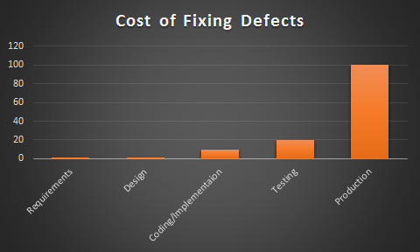
Economics of Software Testing
There is a definite economic impact of software testing. One economic impact is from the cost of defects and the another is the way we perform testing. Cost of defect is a very real and very tangible cost. The second point the way we perform testing will not consider it now.
Many people do not have a solid requirements gathering process
Few people have been trained in or understand the dynamics of requirements
Projects, people, and the world around us change very quickly
The English language is ambiguous and even what we consider clear language can be interpreted differently by different people.

Slide 18


